Slide 1
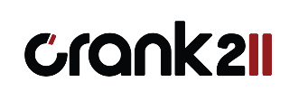
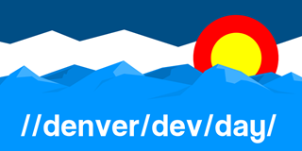

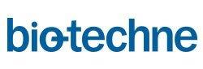




Welcome October 23, 2015
Brought to you by Our Sponsors!

Slide 2
Designer’s Eye for the Development Guy
//denver/dev/day
October 2015
Daren May | Crank211 President
Sarah Voegeli | Crank211 Designer

Slide 3
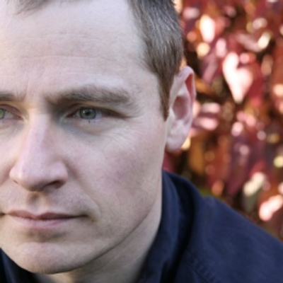
Meet Daren May | ‏@darenmay
Daren May is the President and co-founder of Crank211 — a company that specializes in designing and building next-level digital experiences. Daren has written and presented a number of MVAs and spoken at Microsoft Ignite. He has leveraged Microsoft technologies since the beta versions of Visual Studio .NET and has been developing XAML-based solutions since the heady days of “Avalon” (the early name for WPF).

Slide 4
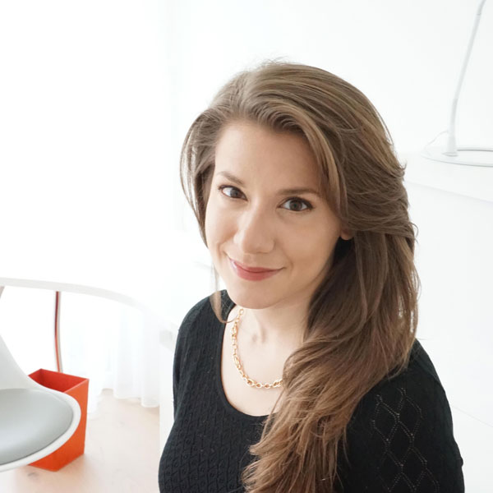
Sarah Voegeli | ‏@sarahvoegeli
Sarah Voegeli is a designer and developer at Crank211 with a strong background in visual design, UX, and web and app development. She specializes in the bridging the gap between design and development with the belief that the best designs are built on an understanding of platforms and people. Before joining the Crank211 team, she was lead designer for a Denver-based software company and taught programming and multimedia classes to students of all ages.

Slide 5
Objectives
Explore the starter app
Evolve the design
Review the improved app

Slide 6
Best app ever review

Slide 7
Improvements

Slide 8
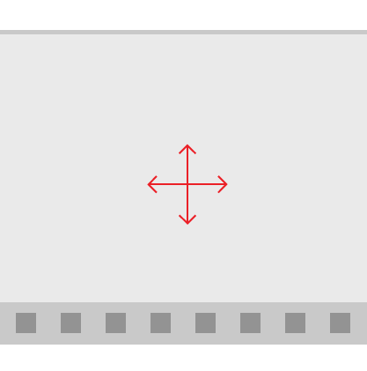
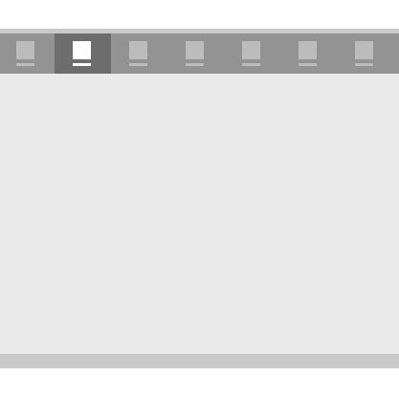
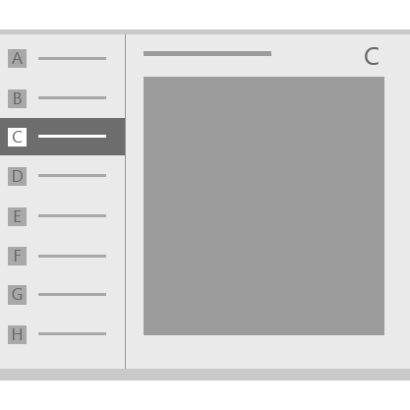
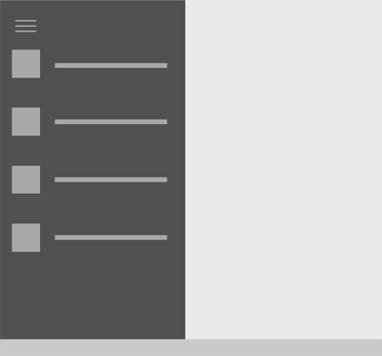
App Patterns
Active Canvas
Tabs and Pivots
Master detail
Nav pane
Hub
Combined patterns

Slide 9
Things to consider
UX
Value Prop
Flow

Slide 10
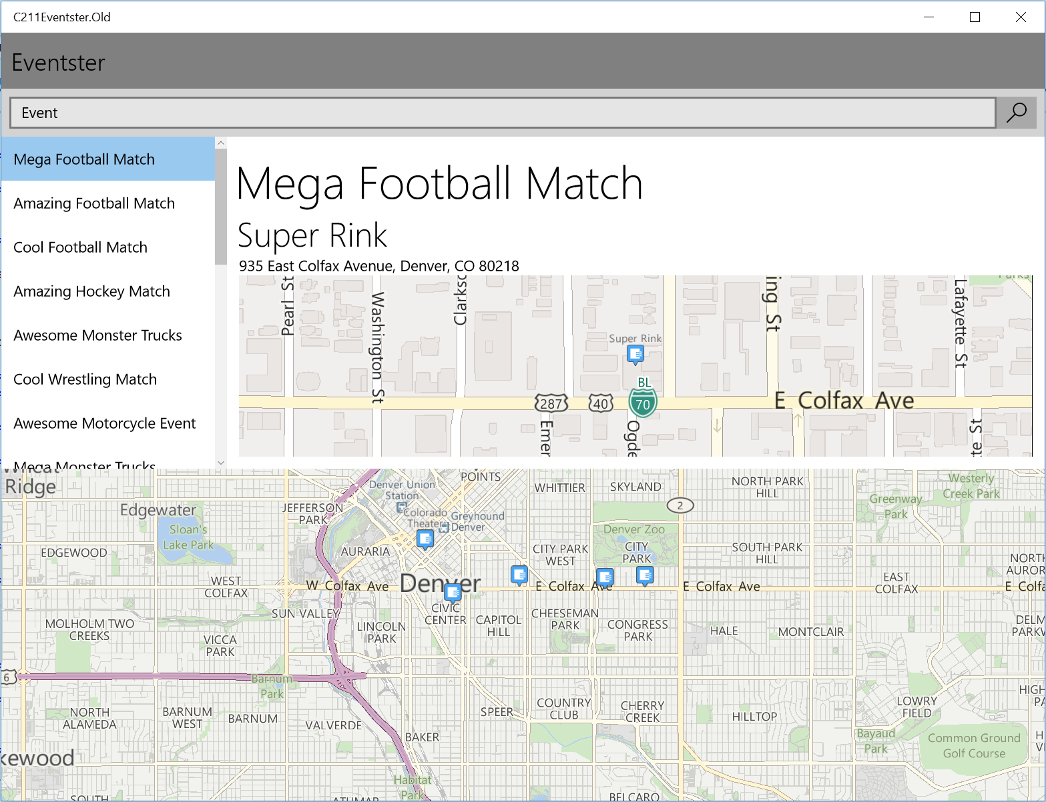
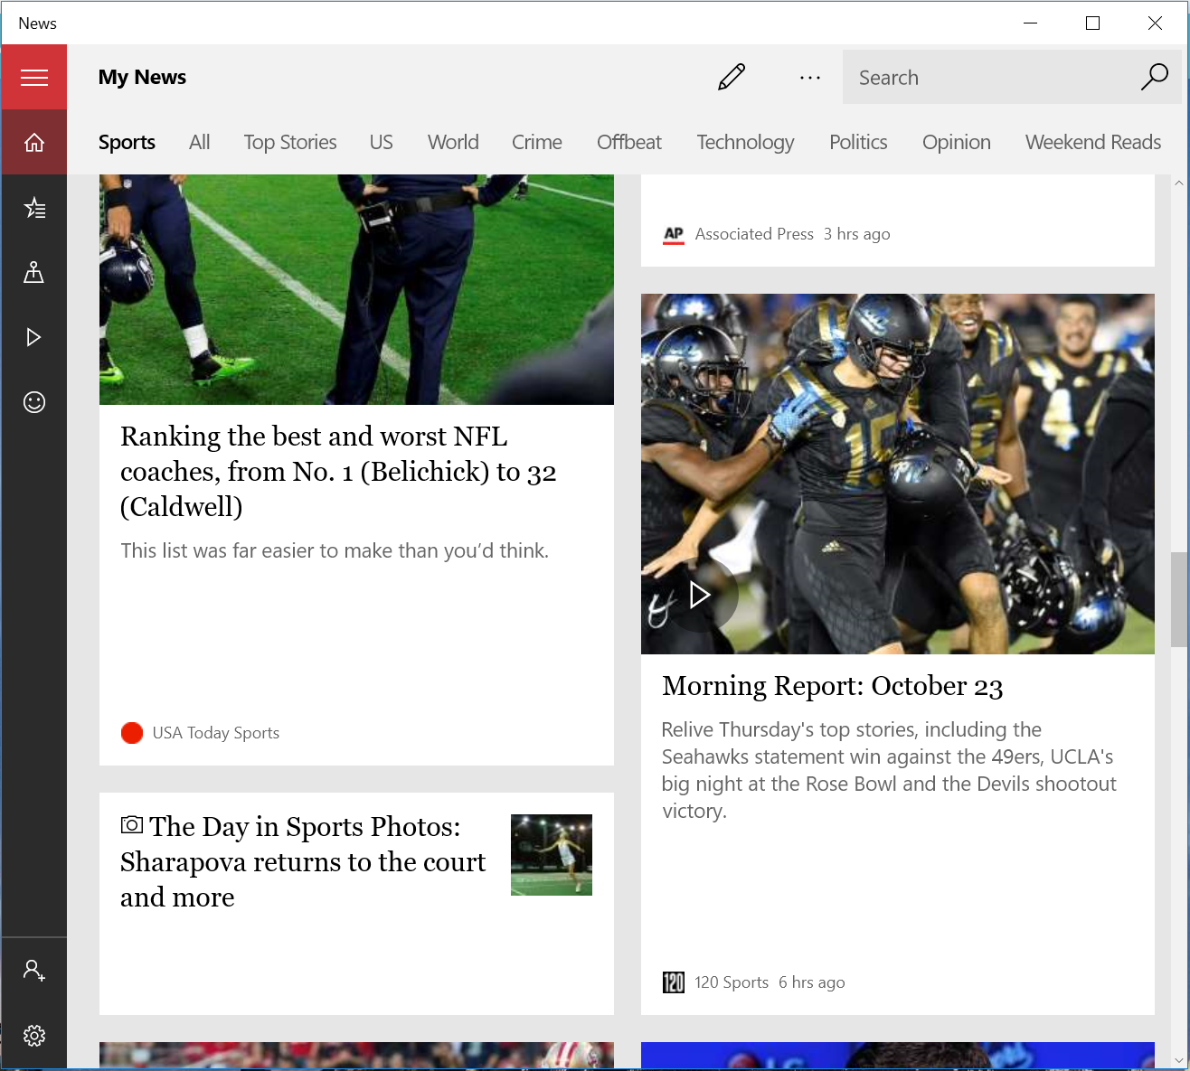
App Comparison

Slide 11
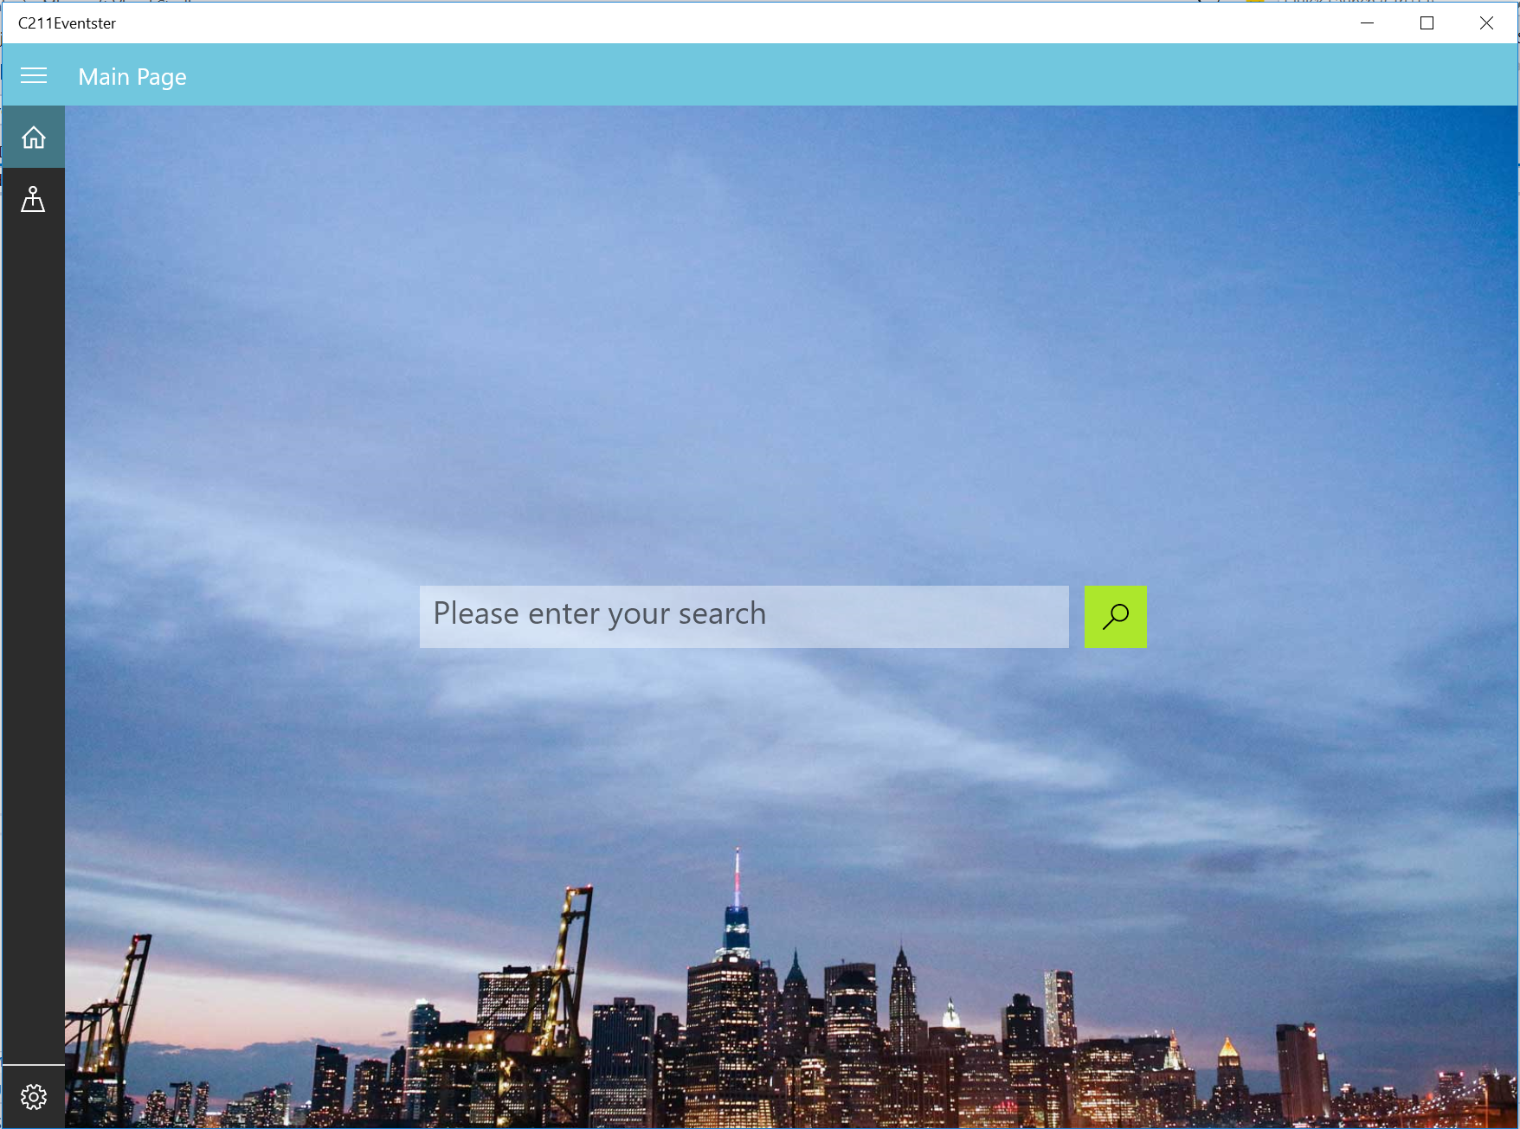
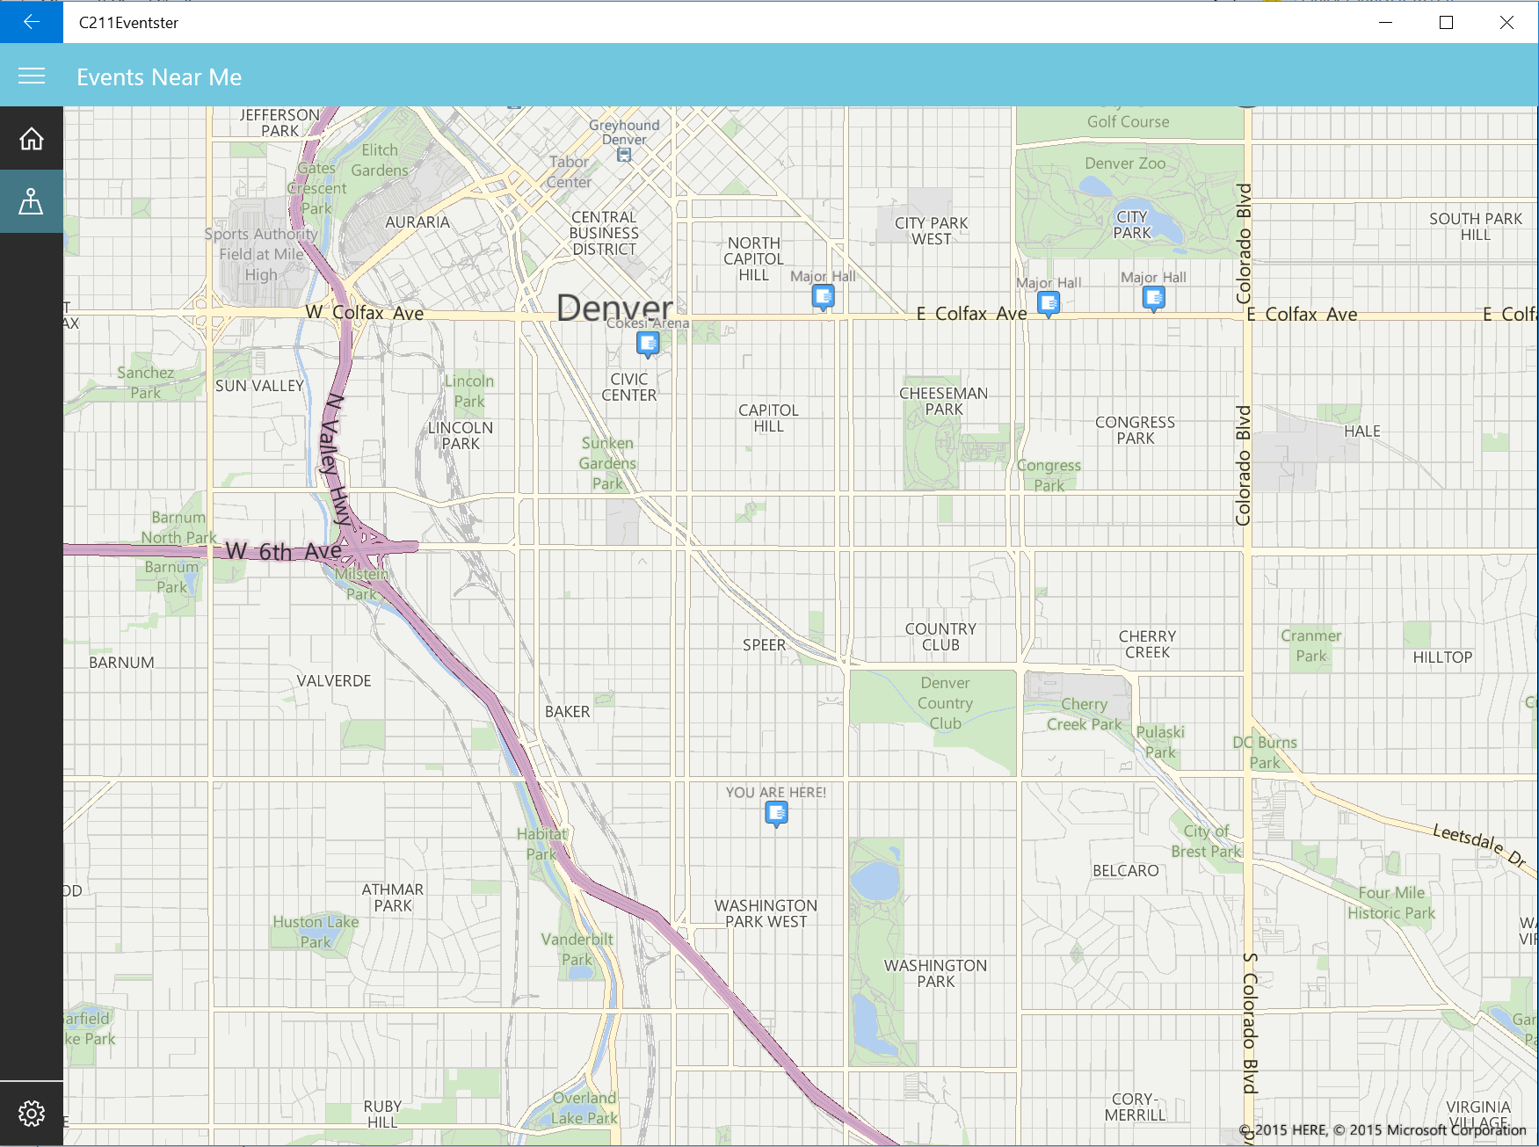
Eventster Pattern

Slide 12
Layout

Slide 13
Welcome October 23, 2015
Brought to you by Our Sponsors!

Slide 14
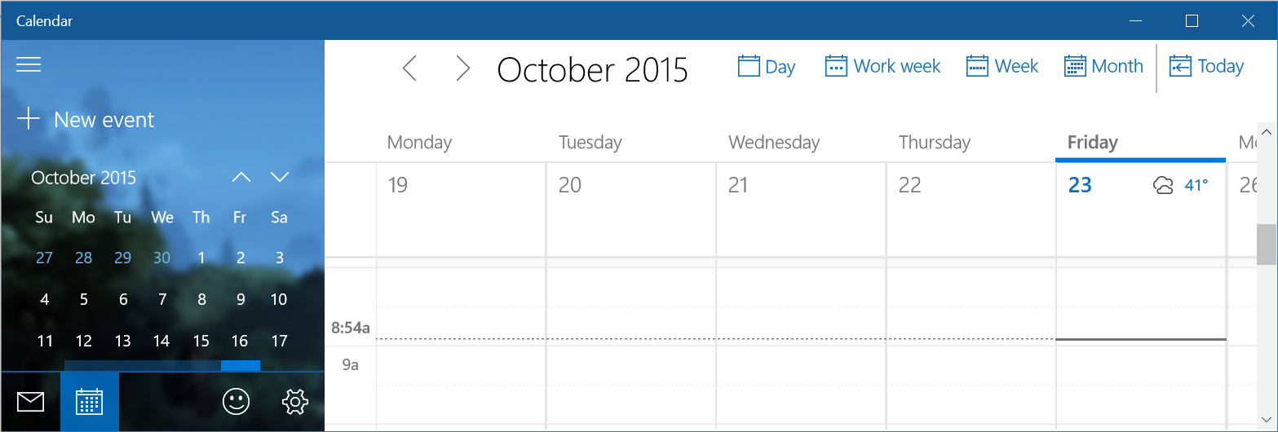
Things to Consider
Define content areas with background fills
Use borders sparingly
Can expand into title bar
Use adaptive and responsive layouts

Slide 15
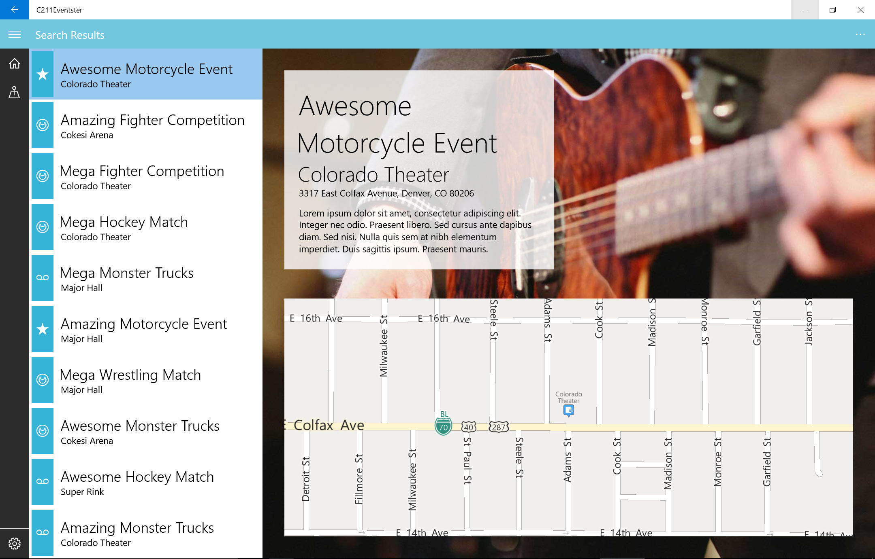
Evenster Layout

Slide 16
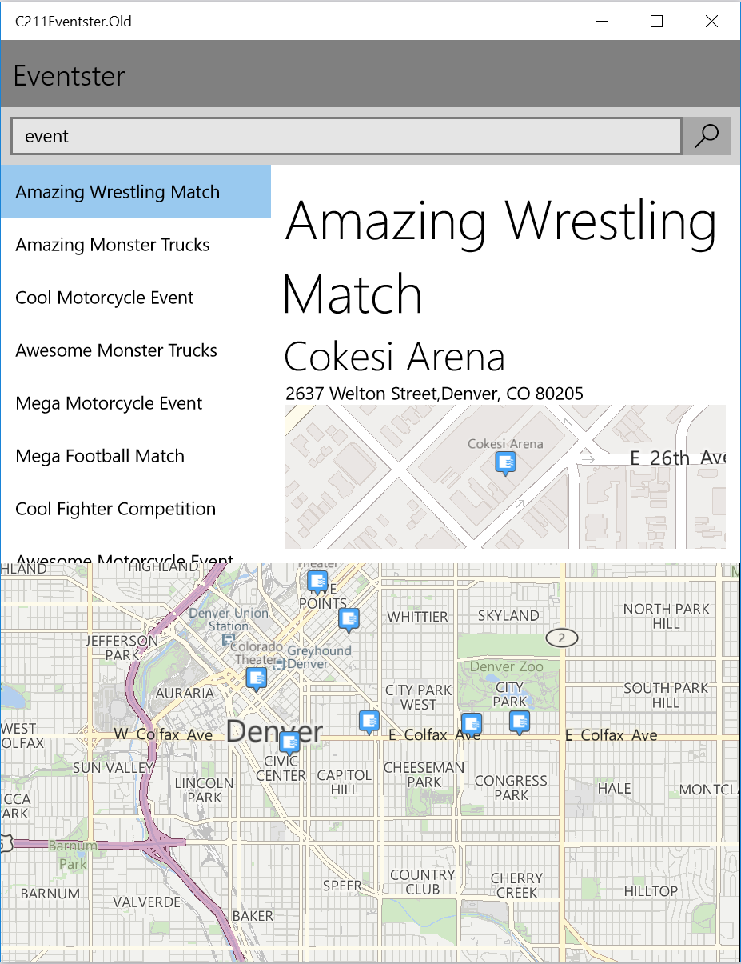
Navigation
Shell back button
Custom back button
Custom back button in title bar

Slide 17
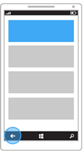
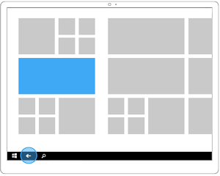
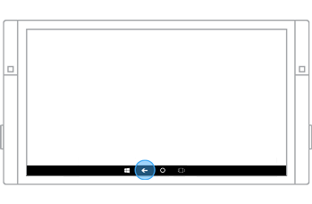
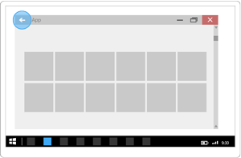
Handling Back Navigation
Phone
Tablet
Surface Hub
Desktop
Notes:
Start for desktop or news Not all devices have a built in back button so you’ll need to change your UI based on whether or not the button exists. Mobile devices always have a back button, so you don’t need to display one in your application. Desktop devices have a back button visible when in Tablet Mode (also called Continuum)

Slide 18
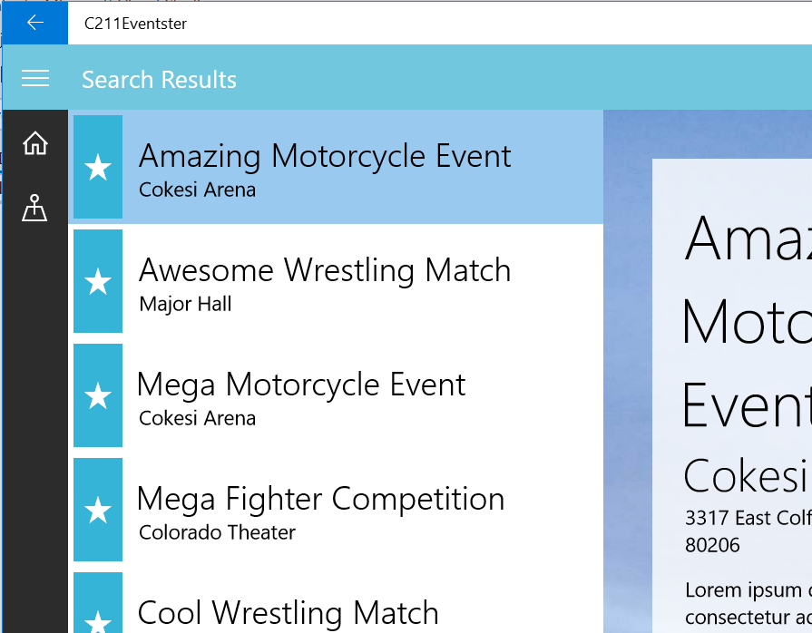
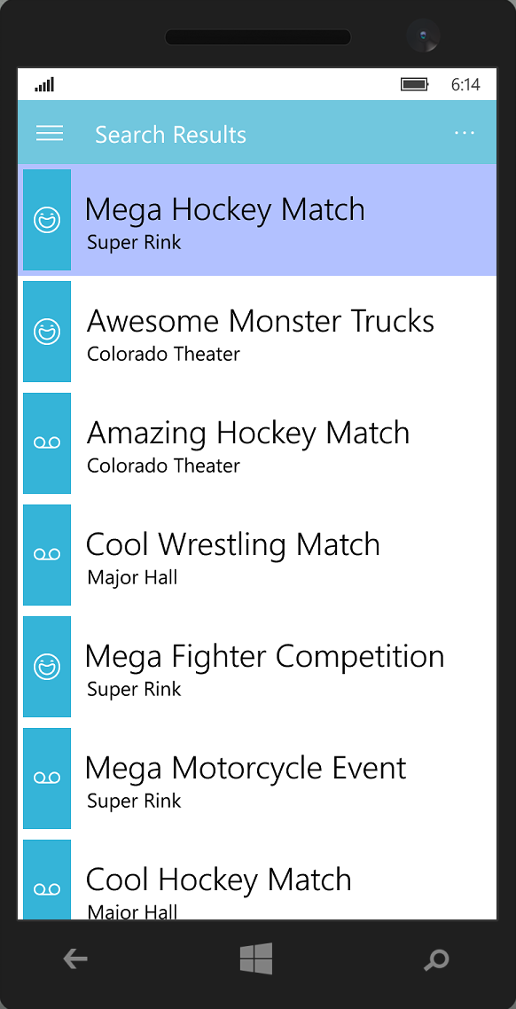
Eventster Navigation

Slide 19
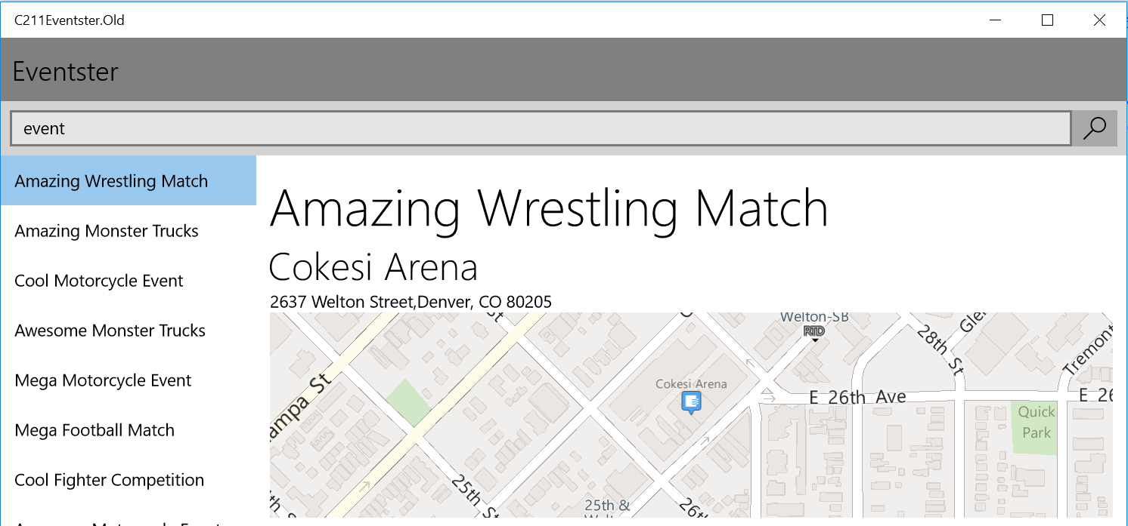
Branding

Slide 20
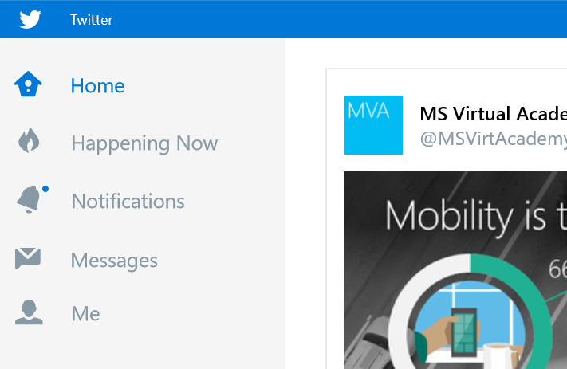
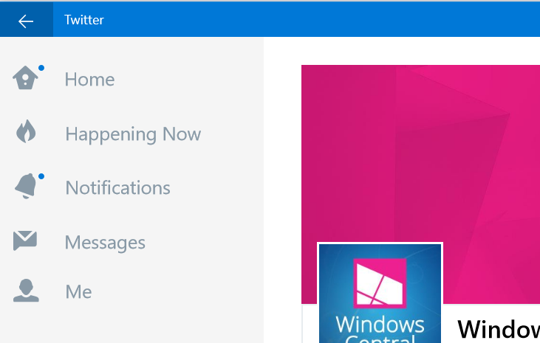
Options for Branding
Logo in page header
Logo in hamburger menu header
Logo mark in title bar is replaced by custom back button
Logo on splash screen only; app name in title bar

Slide 21
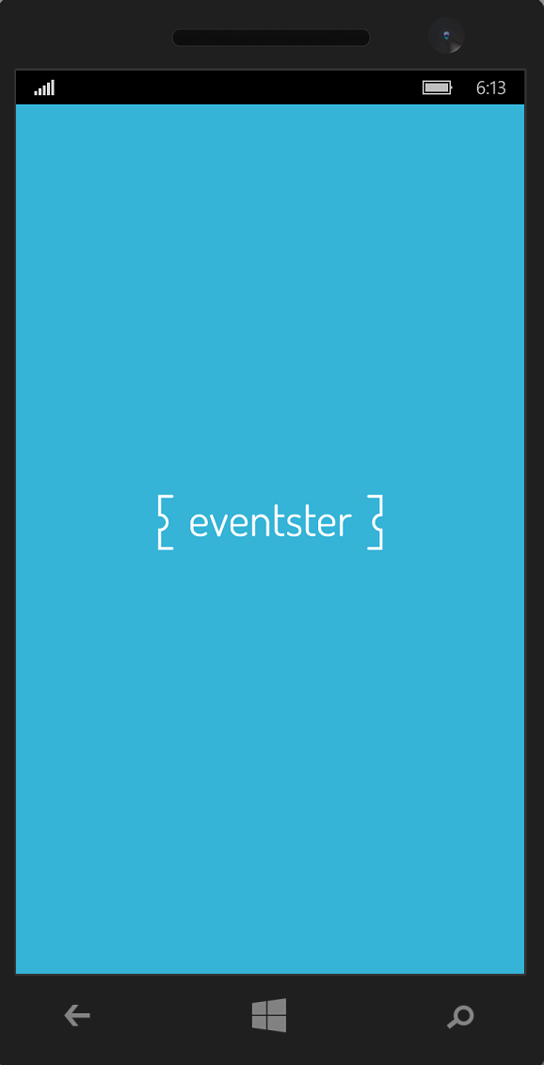
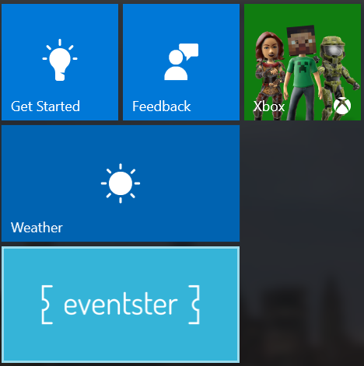
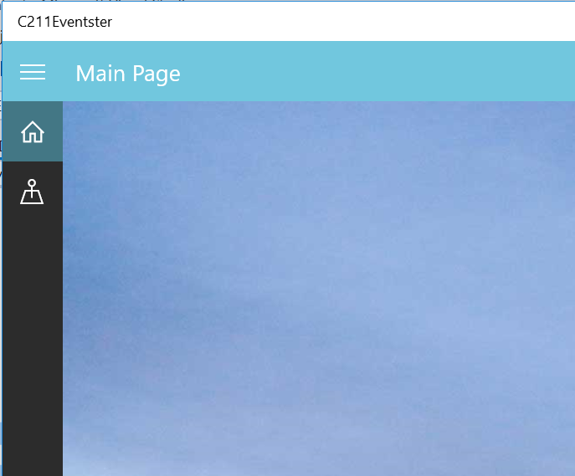
Eventster Branding

Slide 22
Fonts

Slide 23
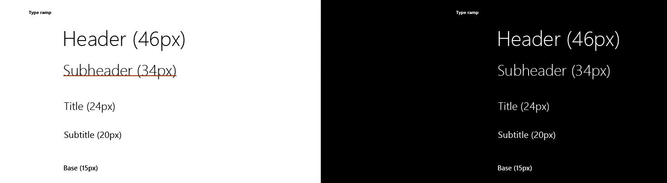
Things to consider
Segoe UI is a reliable design choice
Windows Design templates give size guidelines
Sans-serif is recommended for body copy

Slide 24
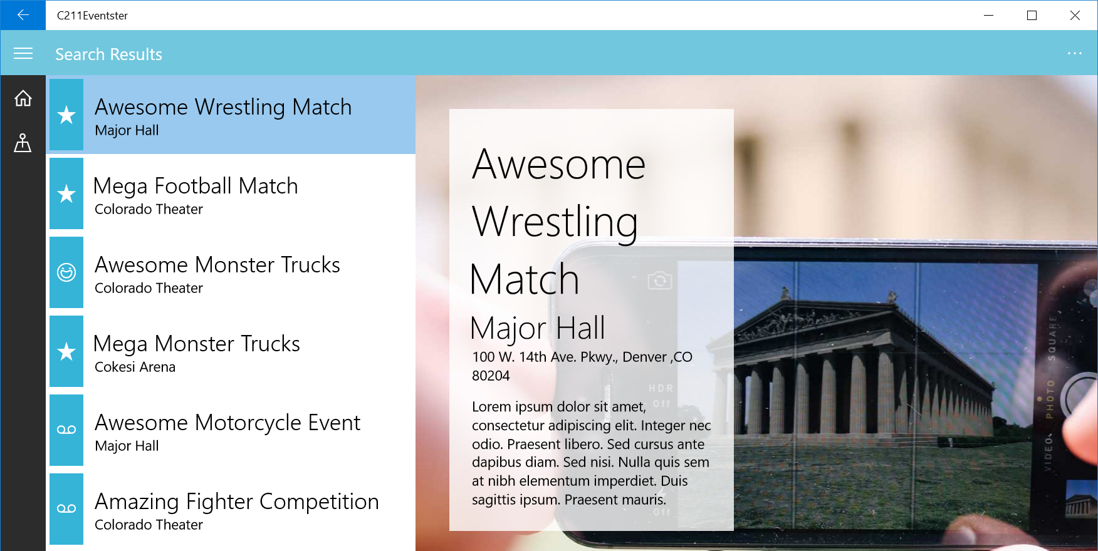
Eventster Fonts

Slide 25
Colors

Slide 26
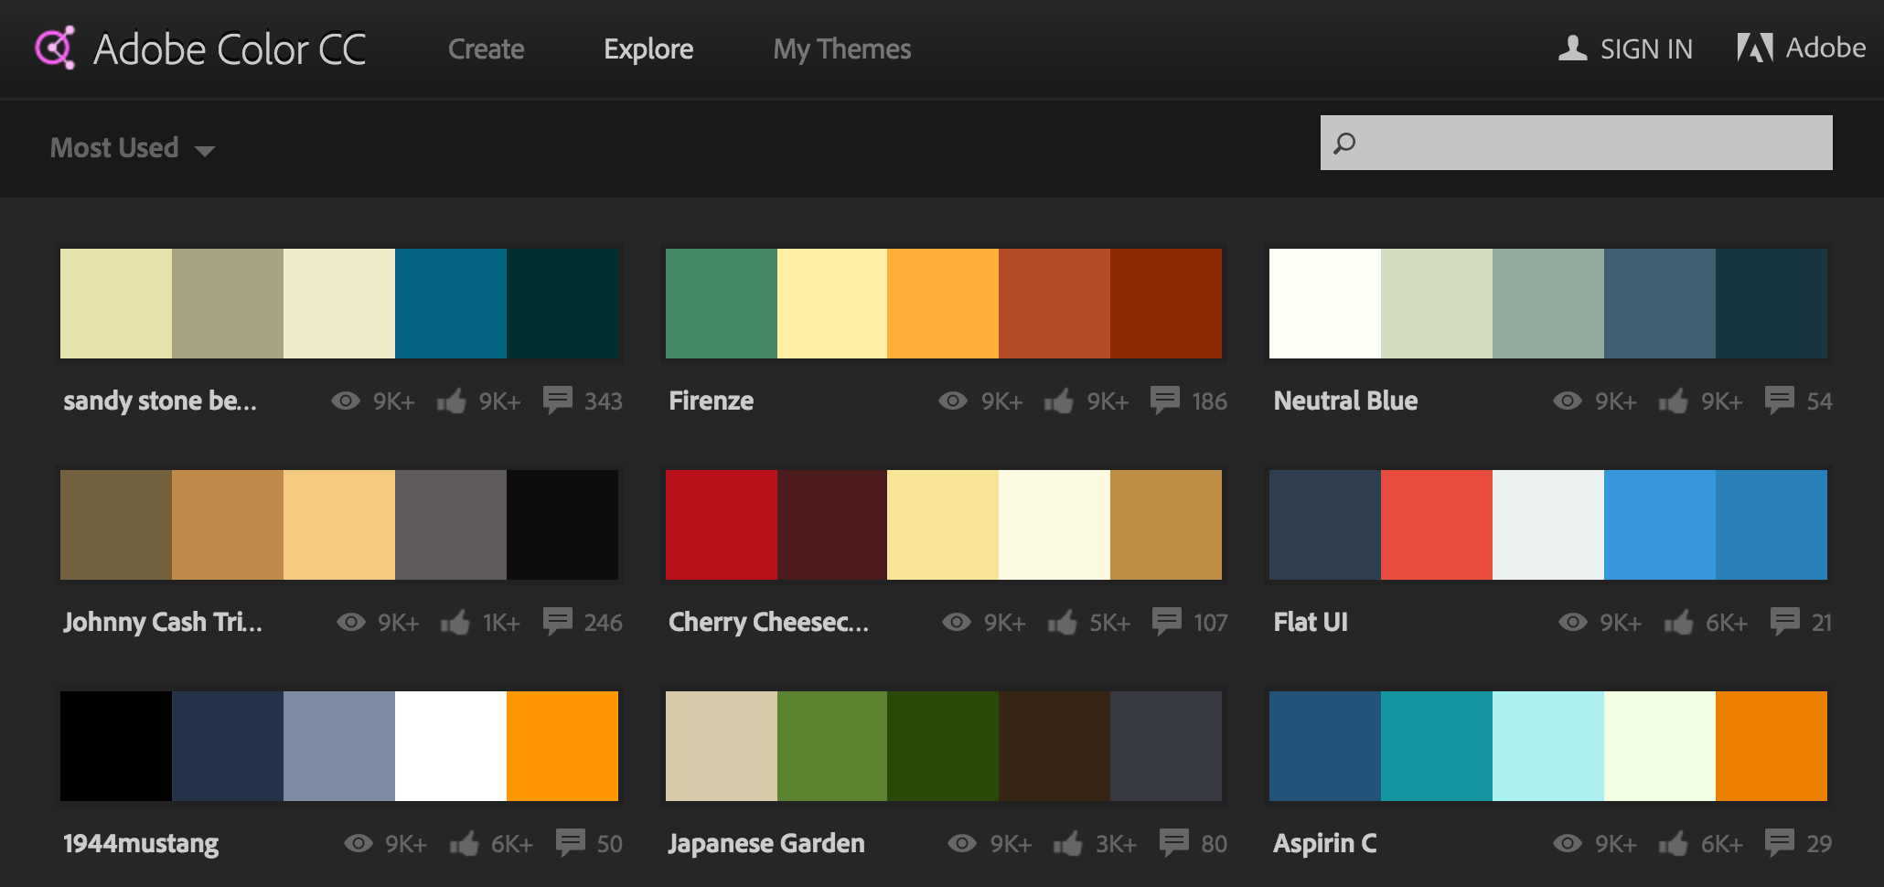
Things to consider
Use a color palette tool
Define primary and secondary action colors

Slide 27
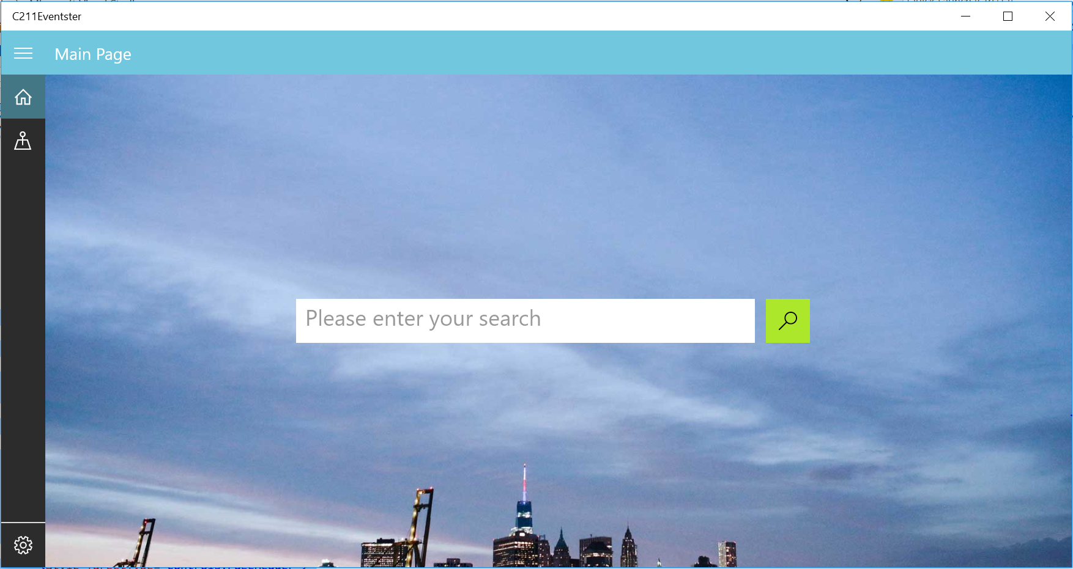
Eventster Colors

Slide 28
The New and Improved App

Slide 29
Summary
App patterns
Layout
Back navigation
Branding
Fonts
Colors

Slide 30
Resources
Windows 10 Design Resources
https://dev.windows.com/en-us/design
Template 10
https://visualstudiogallery.msdn.microsoft.com/60bb885a-44e9-4cbf-a380-270803b3f6e5
MDL2 Icon reference
http://modernicons.io/segoe-mdl2/cheatsheet/

Slide 31
Questions?

